Slide 1
Rangama
A new Anagram game

Slide 2
Game Development Objectives
Utilize latest web development technologies
Collaborate as a team
Have fun!

Slide 3
Major Project Requirements
Use a Node and Express Web Server
Be supported by a MySQL database and an ORM interface
Use GET/POST connection routes
Deploy the app using Heroku
Apply a new library, package or technology
Demonstrate good quality coding practices including MVC folder structures

Slide 4
Game Purpose
Primarily a game for entertainment
A starting point for future enhancements such as multi-player versions, user accounts, rankings, avatars, and .
Potential education use. Anagrams have been used in teaching reading.
Potential tool in psychological research. Anagrams have been used in studies.

Slide 5
Development Hurdles & Decisions
Decision on a application
Negotiation regarding extent of project scope
Merging code from multiple developers

Slide 6
Coding Plan-Front end
HTML/CSS
Anagram Node Package-retrieve list of anagrams
Match words entered to the anagram list
Generate new words
Keep track of score
Submit score

Slide 7
Coding Plan - continued
Back-end
Database
Request pre-existing word & anagrams from MySQL
On the fly response sending with total word score
Server correct pages with Express
Store pre-existing anagrams into the database
Store player score to db

Slide 8
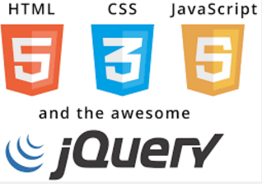
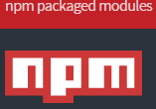
Technologies used:

